Slide 1
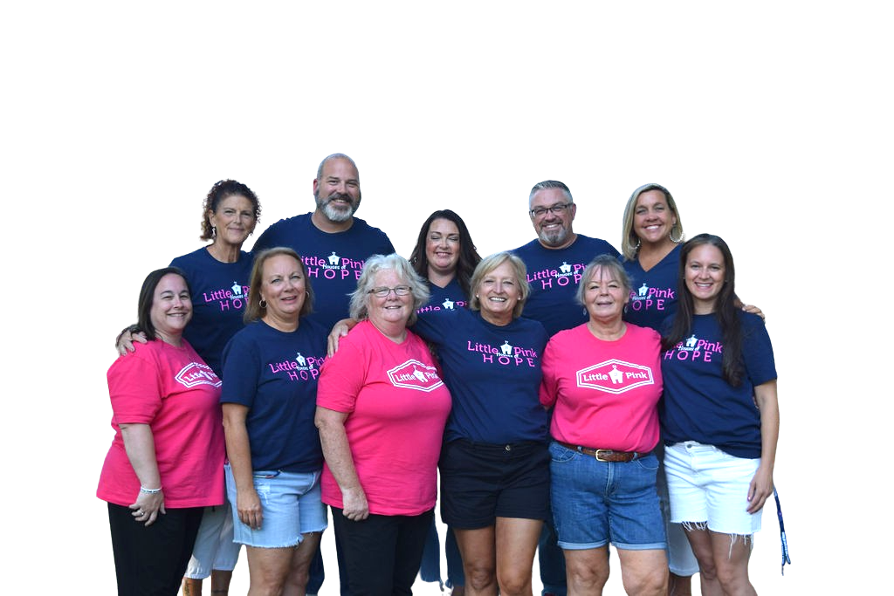
Your
Little Pink
Adventure Starts
NOW
Volunstar Retreat Training

Slide 2
BUILDING TEAMS OF INTENTION
POWER OF INTENTION
Screen 3
WHY ARE WE HERE?
WHAT IS THE PURPOSE OF LITTLE PINK?
REVIEW YOUR FAMILY APPLICATION
1

Slide 3
lp love slide
SIDE NOTES
INTENTIONAL 3
CARE
LITTLE PINK KEY VALUES
1
2
23

Slide 4
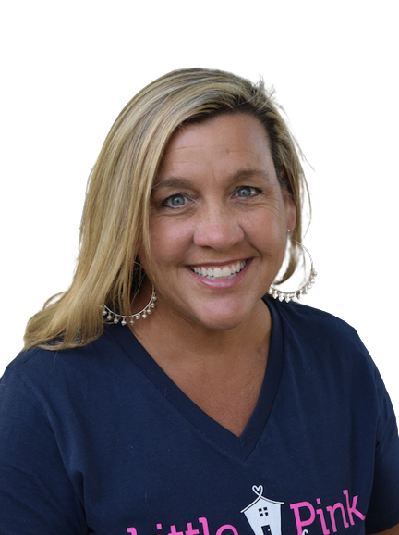
Our story
Who We Are
History
Founded by breast cancer survivor,
Jeanine Patten-Coble in 2010
Have served more than 1000+ families to date
Headquartered in Burlington, NC
https://vimeo.com/64565098?embedded=true&source=vimeo_logo&owner=14792234
Our Mission
Put a huge loving embrace around families as they are going through the physically, socially, emotionally and financially draining cancer journey. Give each family a renewed sense of HOPE!
Our reach
Alabama, Arizona, California, Connecticut, Florida, Georgia, Maryland, North Carolina, South Carolina, and US Virgin Islands.
3

Slide 5
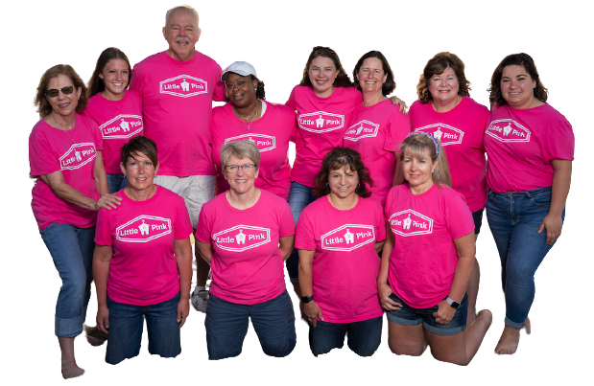
YOUR STORY
Meet the Team
One of the most beautiful things you can do on this earth is let people know they are not alone.
Thank you for serving!
4

Slide 6
We will be INTENTIONAL!
Intentional stewardship- we have been entrusted by local donors and we need to be careful and responsibly manage those relationships.
Intentional connection – our goal is to help form deep bonds between people. We do this by:
making others feel seen and valued!
Having positive energy
building trust
Intentional Inspiration – we want your creative energy, ideas, and enthusiasm! It will inspire our team and our families!
When you are intentional, you choose to make decisions and take action on what's important!
Live Intentionally
5

Slide 7
YOUR ROLES
Meet the Team
Your main goal is to be
"Ridiculously Present"
LP Ambassador
Family liaison
Safety/risk management/liability agent
Team Player
Relationship Builder/Valuing people
Quality control specialist
Cheerleader
What roles did we NOT list?
6

Slide 8
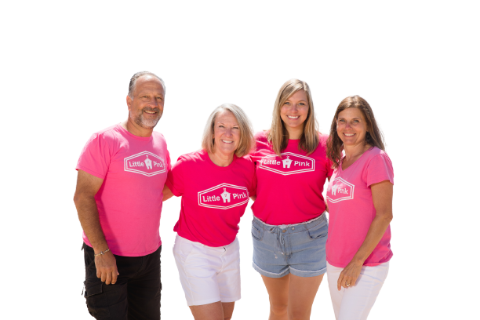
What is your
t-shirt speech?
Be prepared to be ambassador
basic LP info
hook - why are you here?
what does LP mean to you?
website - littlepink.org
give them a business card
Daily basic uniform
LP t-shirt and name tag
7

Slide 9
WE ARE FAMILY!
Family expectations
HOW WE LOVE AND CARE FOR EACH OTHER
Team meetings: We will meet promptly at the assigned time each morning and after the events of the day. Please be ready as directed.
Communication text group, social media, APP
Self-care
Physical, Mental, and Emotional Tasks throughout the week.
We appreciate proactive and observant VolunSTARS
Be prepared to do anything you can to make the week amazing for everyone involved.
Please note: CHILDREN'S safety and well-being are of primary importance! Please understand that your focus and diligence are required to ensure their safety at all times.
8

Slide 10
Volunstar House Jobs
How we Live Together
particpant name badges
organize thank yous
medical kit
trash & kitchen
input thank you information
laundry
photography & upload
LP flag
9

Slide 11
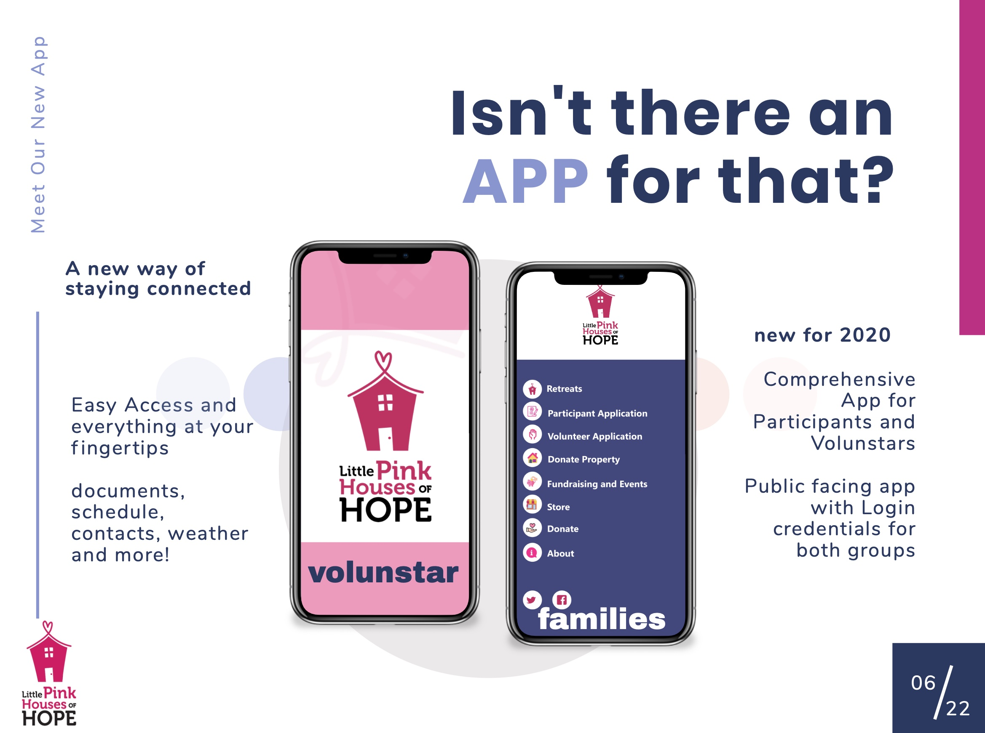
10

Slide 12
SCAVENGER HUNT
APP-TIVITY
HOW WE COMMUNICATE
Which family...
Which volunteer...
Where on the schedule...
Where is ...
11

Slide 13
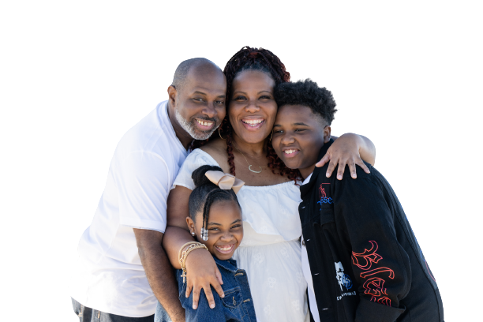
It is ALWAYS all about the FAMILIES
AFAMILY INFORMATION
DO YOU KNOW THEIR NAMES?
Screen 3
Read through information about your family
Ask questions
Share basic info with each other
Family information is to be kept confidential.
Everyone’s journey is different. Try not to come to conclusions about the outcome of the individual’s journey.
Focus on the family, not the diagnosis.
12

Slide 14
Property
Prep
Prepare Participant Houses in Assigned Teams
(only items specified by your leaders)
Linen bag moved inside (if applicable)
cleaning basket (if applicable)
Water
gift bag
yard sign
welcome note written by volunstar
When entering the property, do the following:
-verify entry code works
-verify WiFi works
-verify the water and hot water are on
-verify sheets on beds if no linen bag is present
-locate property notebook/info to share with family
-inspect: note stains, broken items or ones you move, etc.(take photos on phone-send to director)
- select appropriate temp for thermostat
-open blinds or shades
Call or text the director with any issues
13

Slide 15
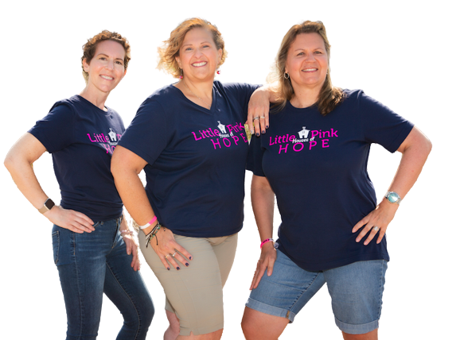
WE ARE A TEAM!
SATURDAY EVENING
DINNER AND TRAINING
Screen 3
TEAM VALUES
TEAM ROLES
LITTLE PINK POLICIES
14

Slide 16
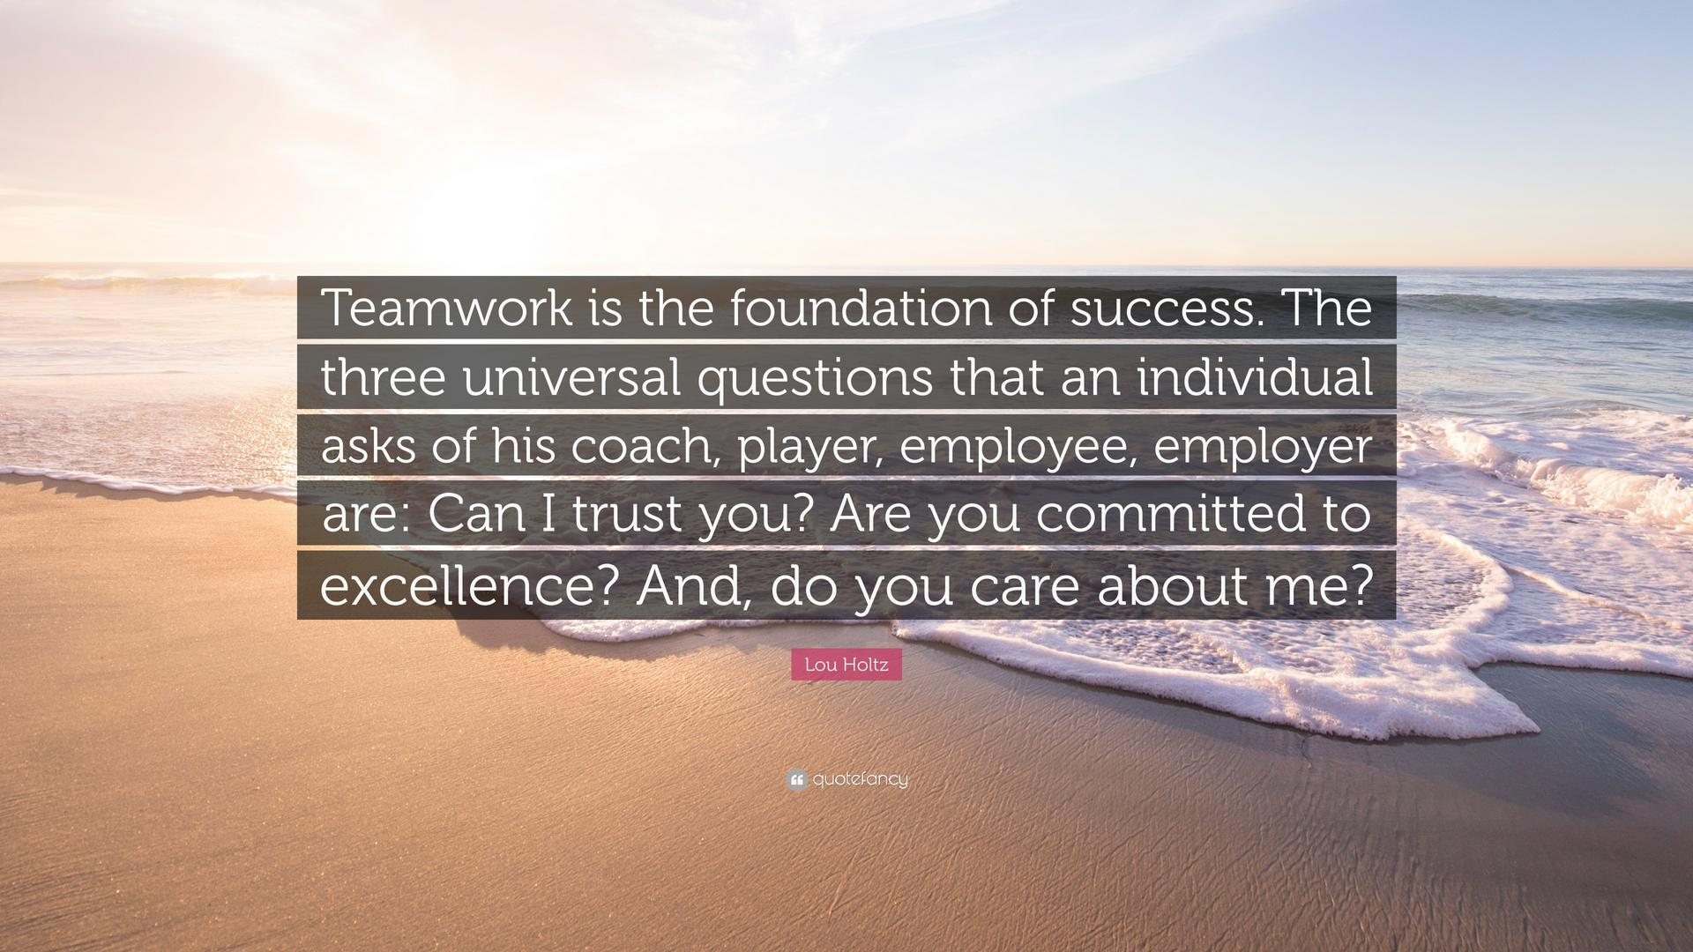
15

Slide 17
WE ARE THE TEAM!
How do we love our families
16

Slide 18
Know your Role
TEAM
PINK
Directs retreat week
Makes early contact with families and VolunSTARS
Financial manager
Makes decisions with coordinator
Leads and loves VolunSTARS as they support families
Facilitates relationships
RETREAT
COORDINATOR
Who's Who of your LP Week
Usually travel to retreat location
Commit to be present 24/7 during retreat
Works with Retreat Director to directly interact with and serve families’ needs
Required to complete training specific to this role
Usually lives in retreat community
Works year round with Retreat Coordinator to develop retreat schedule, donors, support system
Does not have to be present 24/7 during retreat week
Required to complete training specific to this role
Community liaisons
Local in community –spark for LP promotion
Liaison for LP office
Coordinates week – schedule, activities, vendors, meals
In Kind manager collection
Leads and loves Team Pink
Facilitates details
RETREAT
DIRECTOR
VOLUNSTAR
17

Slide 19
WHEN YOU WEAR THE LP SHIRT...
How we represent Little Pink
18

Slide 20
DO'S AND DON'TS
How we represent Little Pink
Let's review the Little Pink policies and guidelines with everyone's favorite game...
CHARADES!
Pick one and give it your best!
19

Slide 21
WHAT DOES IT MEAN TO CARE
How do we love and care for our families
20

Slide 22
SUNDAY MORNING LOVE
How do we love and care for our families
There is nothing more beautiful than someone who goes out of their way to make life beautiful for others.
21

Slide 23
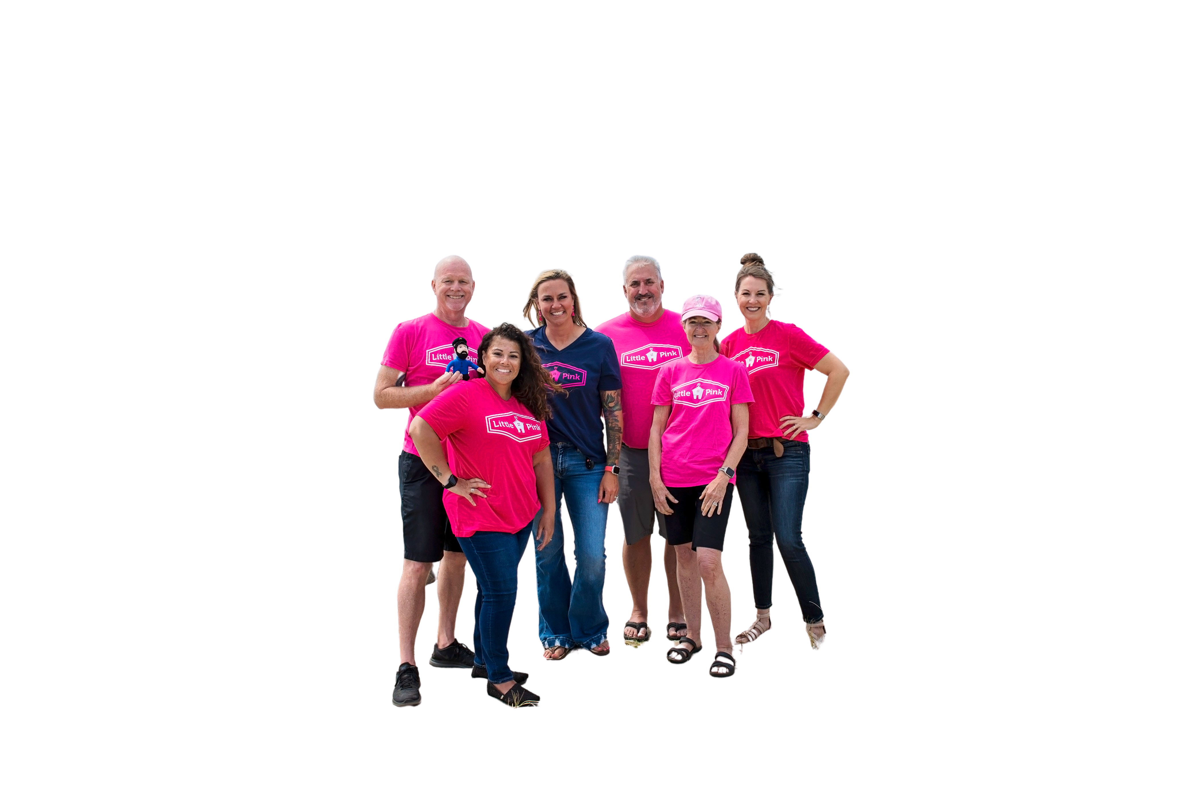
How do we define TEAM?
How we work together to love our families
A small number of people with complementary skills who are committed to a common purpose, performance goals, and approach for which they hold themselves mutually accountable.
22

Slide 24
TEAM DEVELOPMENT
How do we love our families
Live out our core values and expected behaviors
Encourage one another
Communicate well
Problem-solve with grace & feedback
We're all on the same team!
If you can't talk about it,
you can't make it better.
23

Slide 25
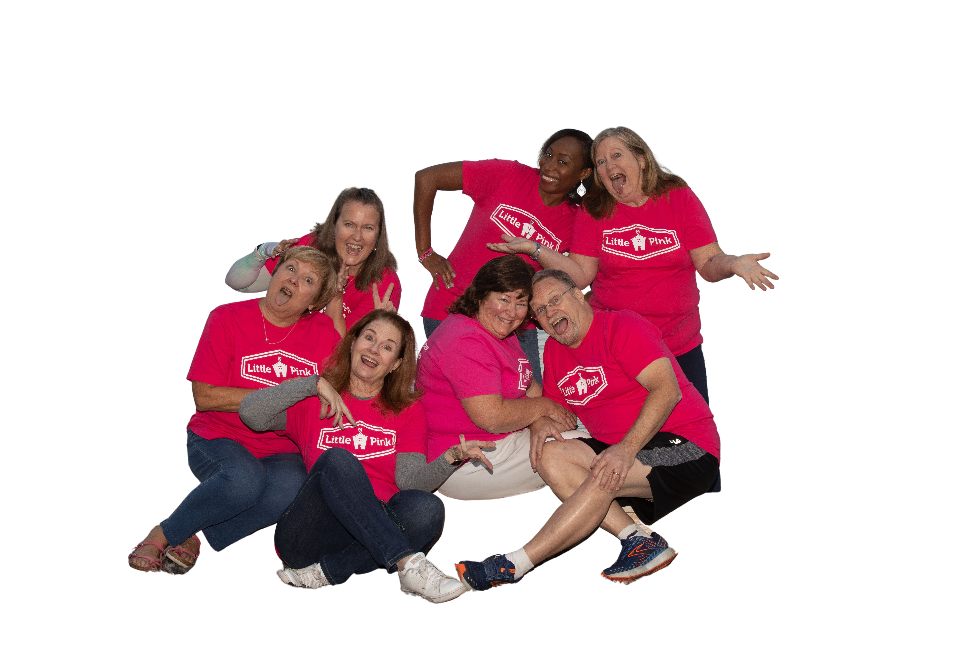
Our goal:
build teamwork & connection!
How do we love our families
How important is TRUST?
“When we feel safe inside an organization, we will combine our talents and strengths and work tirelessly to face difficulties and seize opportunities."
24

Slide 26
Connection can happen if we feel safe enough.
Ease is often a byproduct of feeling safe enough.
Integration is possible when we feel safe enough.
Joy and Laughter come when we feel safe enough.
Healing is a byproduct of feeling safe enough.
Sometimes all we need is to feel safe enough.
How do we love our families
Reflection
What kinds of "safeness" do our families need to experience?
What parts of our schedule and retreat preparations create chances for families to feel safe?
How will we know if we have created safe spaces for our families?
25

Slide 27
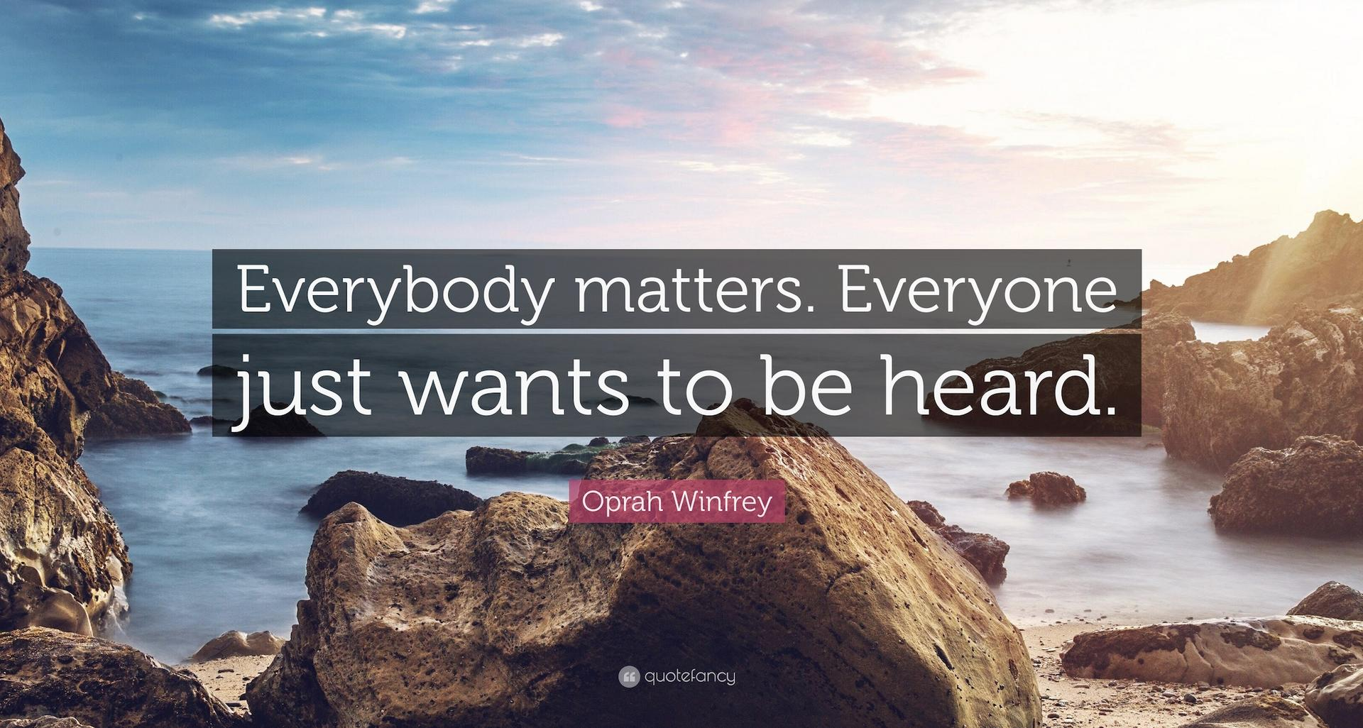
Conversations are
key to Connection
"Hospitality is when someone leaves you feeling better about themselves, not better about you.”
“As a volunteer, you need to be interested, not interesting.”
How do these quotes help you understand how to participate in conversations with the people you will interact with this week?
How do we love our families
26

Slide 28
The schedule has been meticulously planned by the Retreat Coordinator, Team Pink, and the local community to meet the Little Pink goals. Remember to communicate thanks.
Retreat
Schedule
RETREAT SCHEDULE
Everything on the schedule is 100% optional for families. Always encourage your family to come, but never make them feel obligated. Do not take it personally if your family does not participate in all activities; it has nothing to do with YOU or Little Pink.
03
27
08

Slide 29
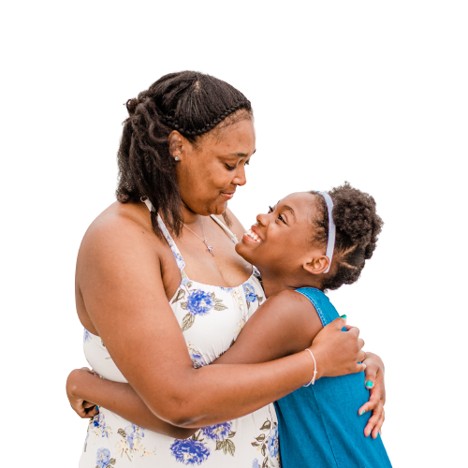
Pre Check-in FOCUS
Do you know their names?
Become familiar with the schedule
Review shared photo album process for saving candid photos
Review your assigned Family's names
Help organize any items for families (baskets, gifts, etc. if necessary) or for check-in
Enjoy getting to know your LP team!
28

Slide 30
Check in your family
Keep a balance between forming relationships and information
Guide family to their volunstar- do not little pink mob them!
Bathroom, snacks, assist with children
Check in Directions
1
Introduce yourself to your family. Share your excitement.
Tell them your role for the week - contact you for information, relay changes, etc.
Verify family members are in attendance.
Verify participant has APP downloaded.
Send the text with house info to family and verify they understand info, especially entry info. (code, etc.)
2
3
Remind family of dinner location and time.
Escort them to the Retreat Director for gift card and other items.
29

Slide 31
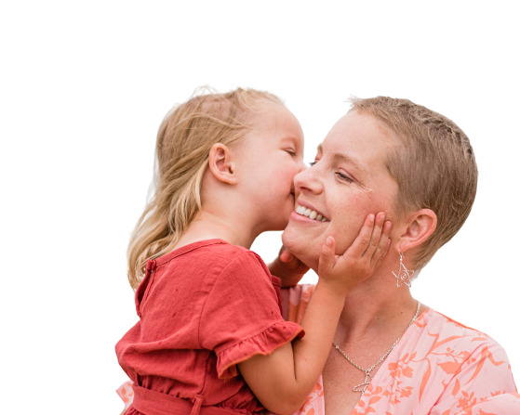
Dinner Responsibilities
Opening Dinner Directions
Greet your family
Seating- priority is families sitting with other families and then their volunstar. Help your family meet other families.
Help integrate Team Pink
Offer to help parents with kid plates
Help as needed with clearing tables, etc.
Director will introduce volunstars & families
After dinner, the Director will conduct a short meeting with the families. According to your location, children may or may not be included in this meeting. If childcare is needed, instructions will be given.
30

Slide 32
WE "LOVE" YOU!
Closing Thooughts
31

Slide 33
CUE THE MUSIC!
Closing Thooughts
We are the LOVE MACHINE!
32

Slide 34
Closing Thooughts
33

Slide 35
THE END!
Closing Thooughts
34

Slide 36
JENGA
Closing Thooughts
35

