Slide 1
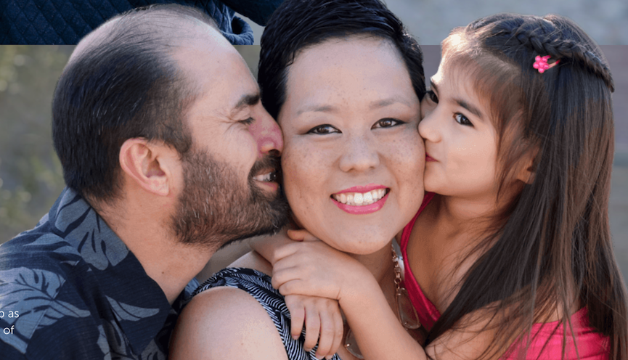

Little Pink
Brings Hope to Breast Cancer Families
NOW

Slide 2
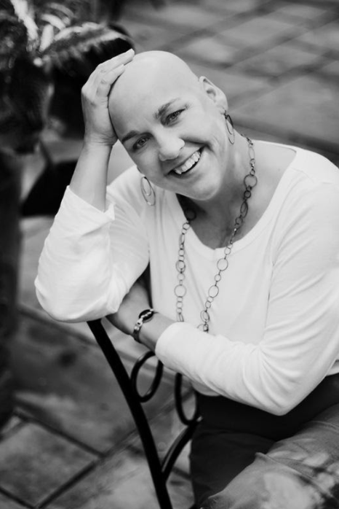
In a Moment
Your Life
Can Change
History
Founded by breast cancer survivor,
Jeanine Patten-Coble in 2010
Have served thousands of families to date
Headquartered in Burlington, NC

Slide 3

How we LOVE
Our Mission
Put a huge loving embrace around families as they are going through the physically, socially, emotionally and financially draining cancer journey. Give each family a renewed sense of HOPE!
"Spread LOVE every-where you go. Let no one ever come to you without leaving HAPPIER."
Mother Teresa

Slide 4
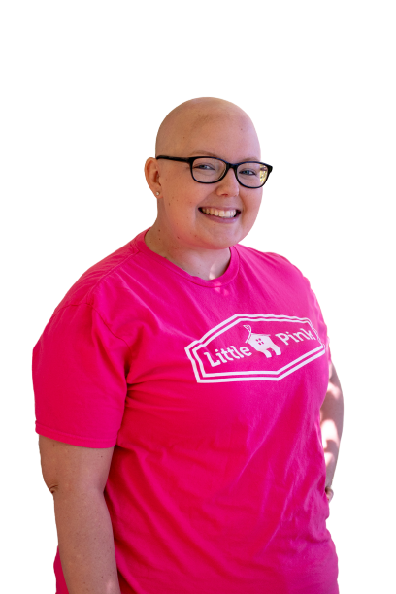
Week-Long Retreats!
Orange Beach, AL
Scottsdale and Sedona, AZ
Lake Tahoe and Pismo/ Avila, CA
Estes Park, CO
Niantic, CT
New Smyrna Beach and Key West, FL
Blue Ridge, GA
Ocean City, MD
Grand Haven and Manistee, MI
Carolina Beach, Topsail, Emerald Isle, Oak Island and Outer Banks, NC
Myrtle Beach, SC
St. John, US Virgin Islands
Manual Antonio, Costa Rica
9-22 FAMILIES each

Slide 5
Empowering Group Activities in each
week-long retreat
39
Activities focus on all
members of the family
Average age
of breast
cancer patient
attending
"Our Little Pink retreat was a miracle all wrapped up in a big pink bow! My family and I will always hold this place dear to our hearts."

Slide 6
A structure that leverages existing compassion
Retreat
Location
Local
Businesses
Community
Orgs
Local Coordinator
Little Pink Director
House
24/7 volunteers and Team Pink
Meals & Activities
support &
relationship focused

Slide 7
Schedule has been meticulously planned by Retreat Coordinator, Team Pink and local community to meet the
Little Pink goals for each day.
Retreat
Schedule
Everything on the schedule is
100% optional for families.
03
08

Slide 8
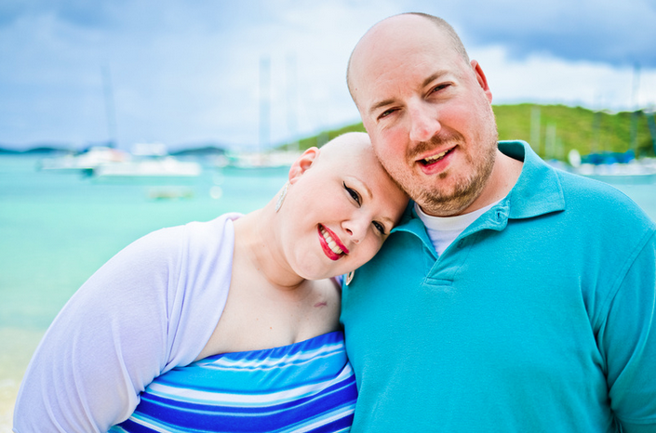
The POWER OF MOMENTS
An EPIC week!
Elevation
Pride
Insight
Connection
Screen 3
E
P
REVIEW YOUR FAMILY APPLICATION
I
C

Slide 9
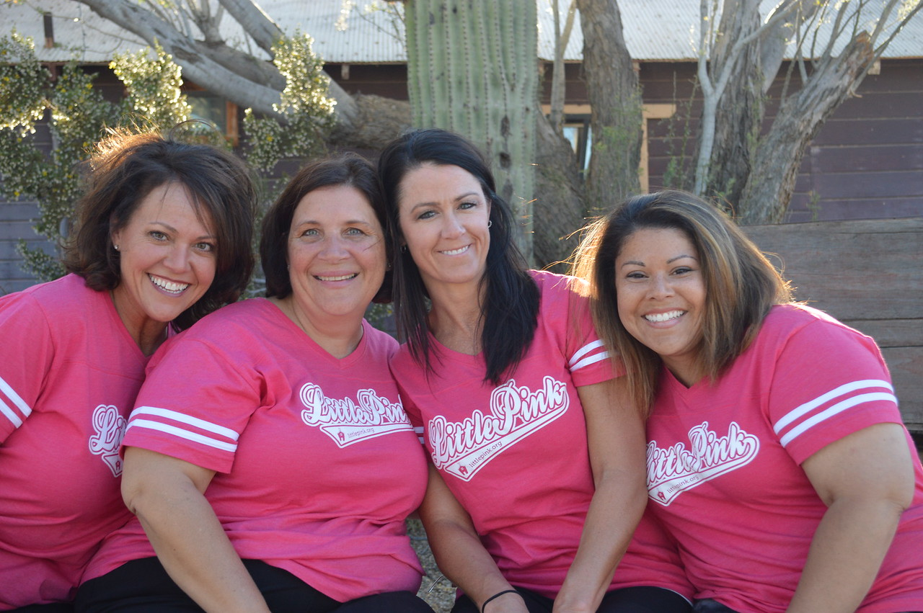
Our job:
Be RIDICULOUSLY Present
With families
With volunteers
With Team Pink
With community members
With self

Slide 10
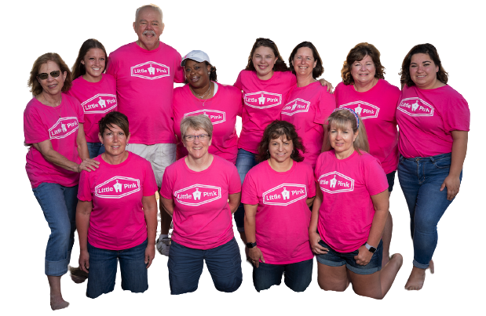
Volunteers make it possible
What brought you to this place at this time?
What do you want this week to do for your soul?
What is a strength that you have that will make a difference for the team or families?
What brings you joy?
“No one is more cherished in this world than someone who
lightens the burden of another. ”

Slide 11
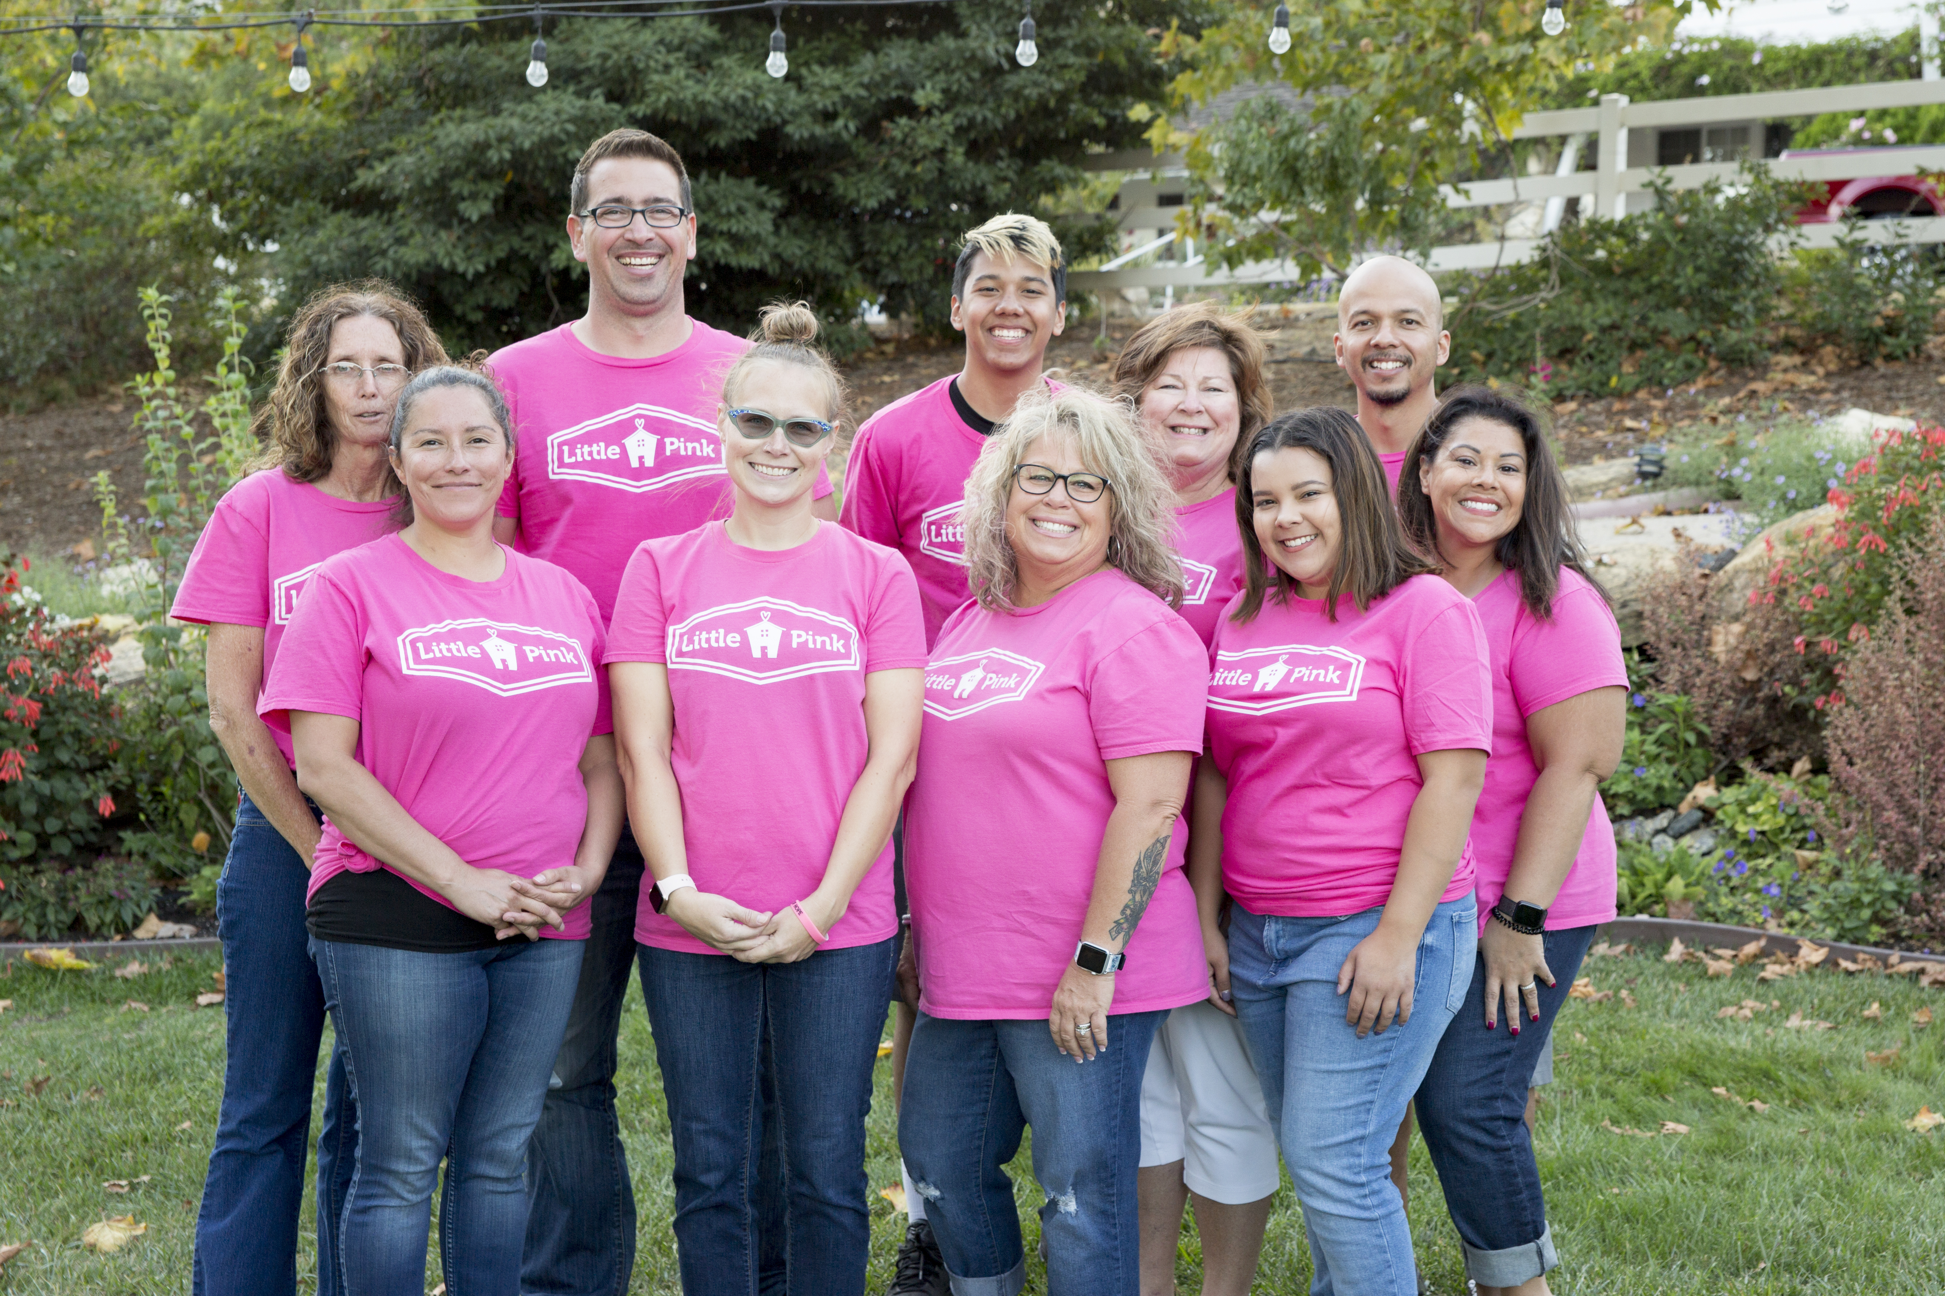
HOPE over Covid
Doubled our work!
Virtual Retreat Weekends
Retreats with Limited volunteers and Visa Gift Cards
Boxes of Hope
A Battle
Against
Isolation

Slide 12
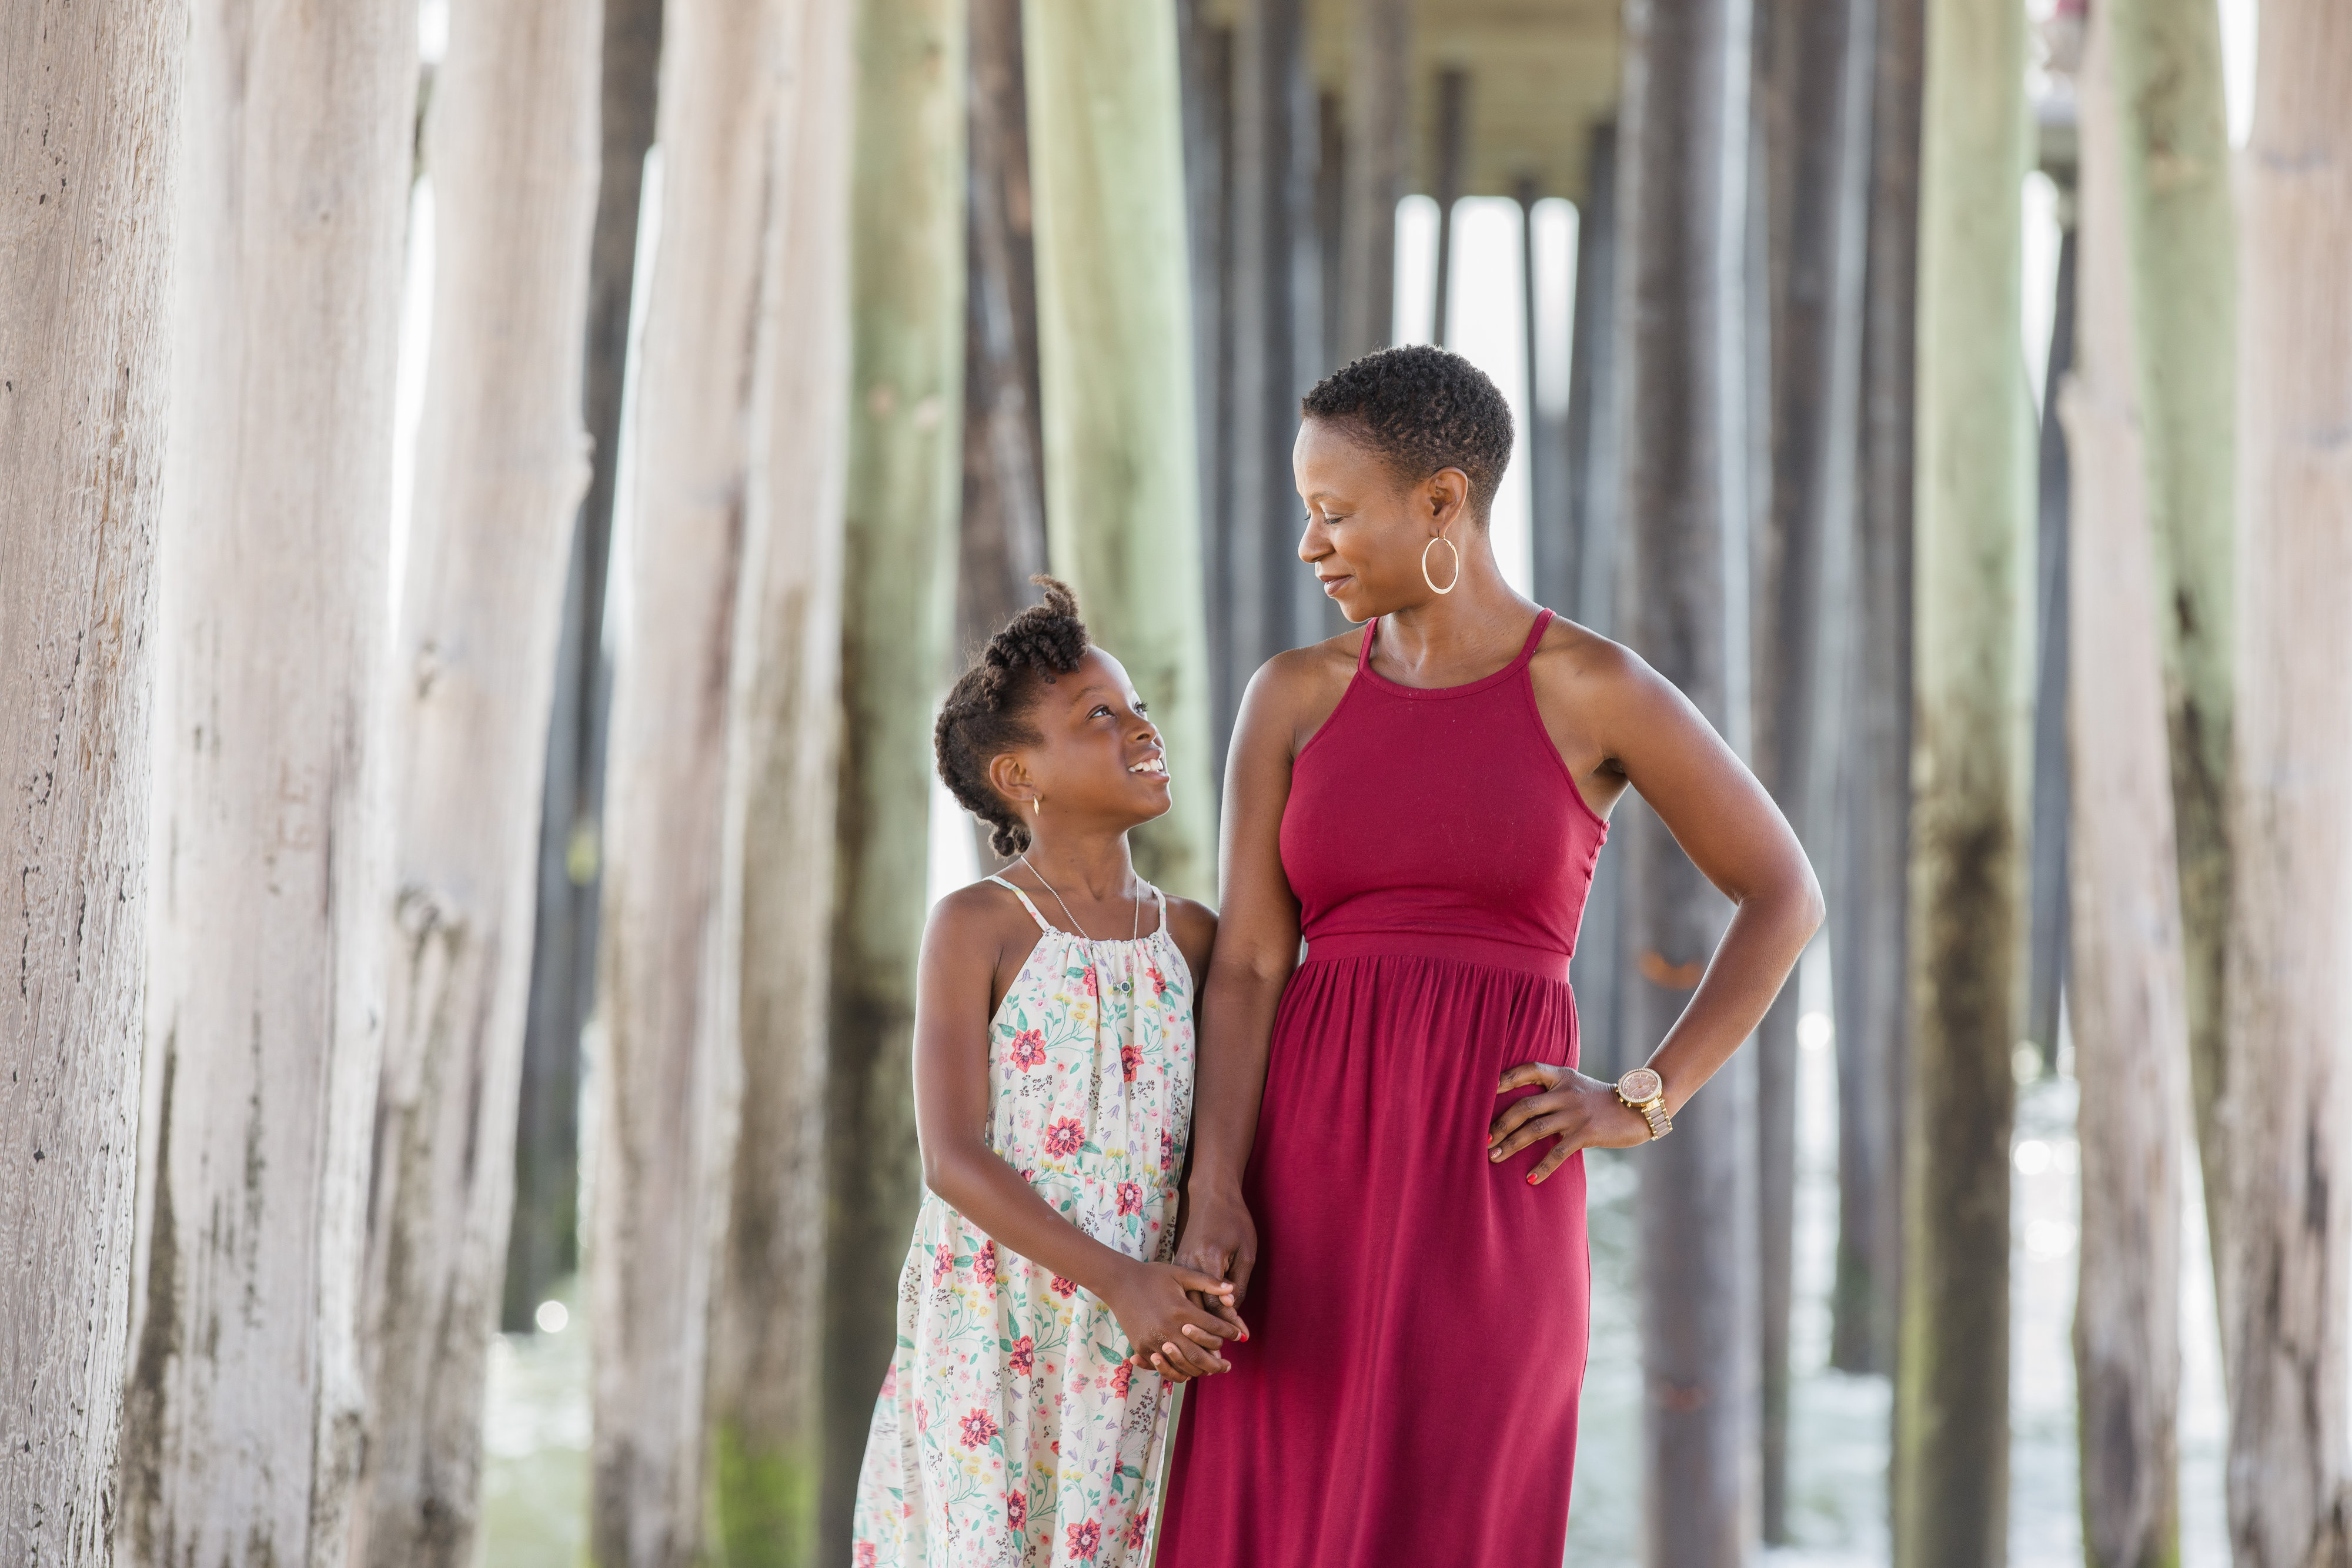
Impact
Decrease Stress Level
Increase opportunities for peer engagement
Normalize cancer journey for kids
Decrease financial burden
Create a long-term network of support
Come as strangers, leave as family

Slide 13
Contact Us
For more information visit
LittlePink.org
To volunteer, donate, or share your vacation house, please visit our website
email Jeanine @LittlePink.org
336-213-4733
To read about Little Pink’s Story,
Order Struck by Hope on Amazon
24
24

